Slide 1
WESyS Q4 milestone
Danny Inman and Annika Eberle

Slide 2
Testing VBSA
The objective of this study is to:
Test our VBSA code
Test rmarkdown and knitr

Slide 3
Methods
We created a dummy dataset “foo” with 1000 observations of 5 variables
We used the folling model: lm (f4 ~ ., data = foo)
Sobol Quasi-Random Sequences was used to design a study with 50000 replications
The model was run with the Sobol Desing and the output were collected

Slide 4
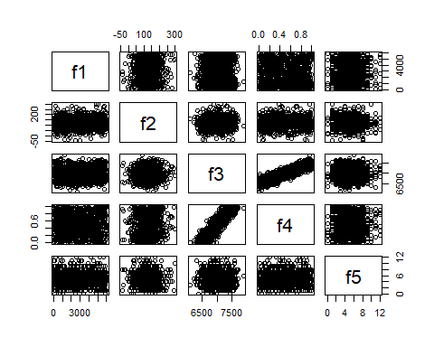
Plot of foo output

Slide 5
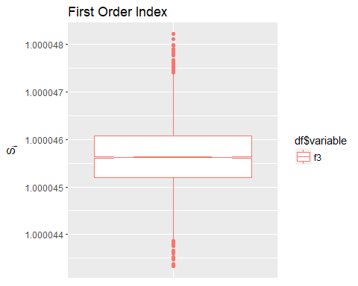
First-Order Results

Slide 6
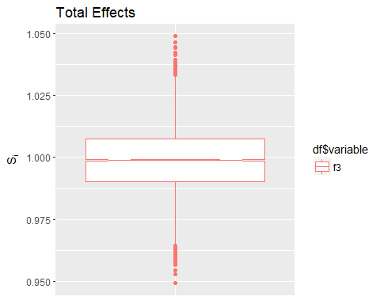
Total Effects

Slide 7
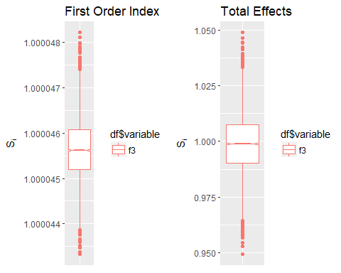
Conclusions

Slide 8
Conclusions - cont…
-Of the five factors tested, f3 was the most impactful
Notes:
testing the notes function here
we can add notes to each slide through markdown

